Slide 1

Measurement of the fragmentation of Carbon ions with nuclear emulsions for medical applications
Adele LAURIA
On the behalf of Naples emulsion group
University of Naples “Federico II”, Italy
INFN, Naples

Slide 2
Outline
  Hadrontherapy motivation
  The ¹²C fragmentation measurement with the Emulsion Cloud Chamber (ECC) detector
  The FIRST detector
  Measurements at GSI in the FIRST set-up
  Preliminary results
  Conclusion

Slide 3
Outline
  Hadrontherapy motivation
  The ¹²C fragmentation measurement
  The Emulsion Cloud Chamber (ECC) detector
  The FIRST detector
  Measurements at GSI in the FIRST set-up
  Preliminary results
  Conclusion

Slide 4
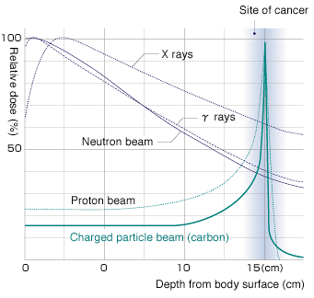
Hadrontherapy motivation
For hadrons (compared to X and γ):
  Energy deposited at the end of ionization range
For ¹²C (compared to protons):
  Reduced lateral and longitudinal diffusion;
  Higher therapeutic effectiveness;
  Tissue thickness tunable by changing the nuclei energy;
  Less energy deposited to healthy neighboring tissues

Slide 5
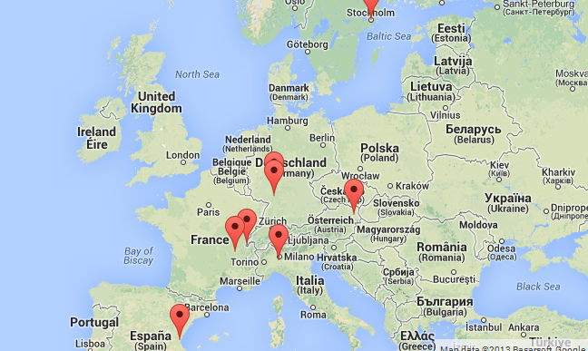
Hadrontherapy
Facilities in Europe:
http://enlight.web.cern.ch/facilities

Slide 6
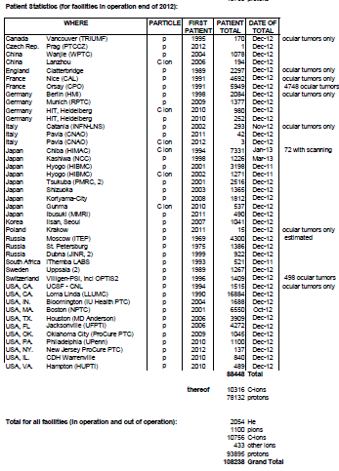
Patient Statistics (for facilities in operation at the end of 2012):
http://enlight.web.cern.ch

Slide 7
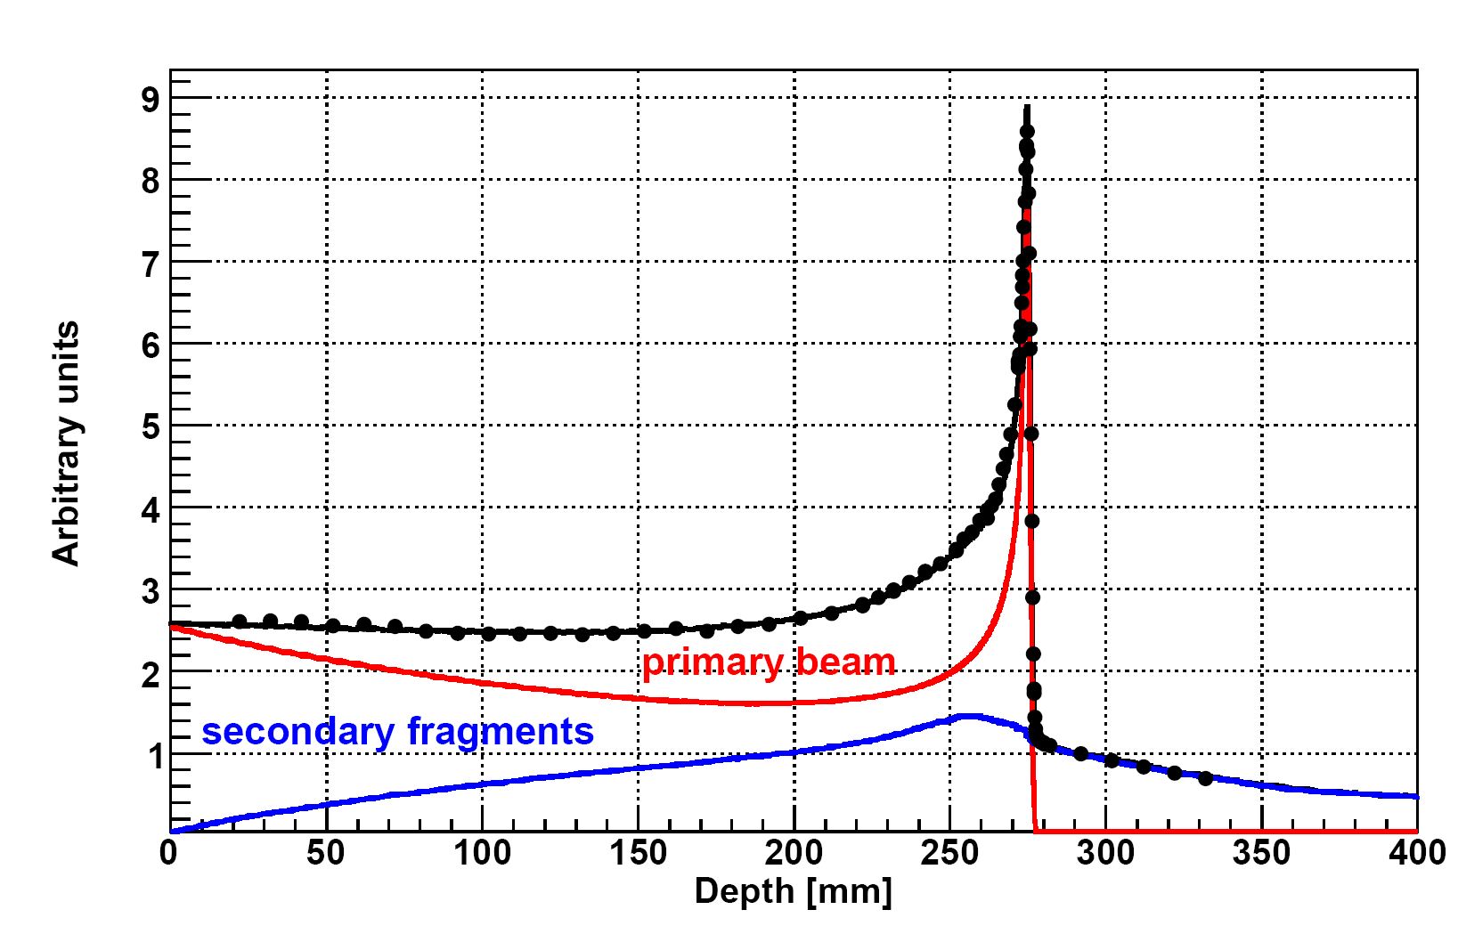
  Fragmentation of ¹²C
Nuclear fragments are generated during the interaction inside the tissue
Fragments have higher range and different direction with respect to primary ions
Precise knowledge of fragments is necessary to predict the detailed irradiation of the neighboring tissues and, thereby, optimization of the therapy with higher effectiveness
  What we need to know
Kind of fragments
Which energy?
Which angle?
¹²C (400 MeV/n) on water Bragg-Peak
Simulation: A. Mairani PhD Thesis, 2007, Nuovo Cimento C, 31, 2008

Slide 8
Outline
  Hadrontherapy motivation
  The ¹²C fragmentation measurement with the Emulsion Cloud Chamber (ECC) detector
  The FIRST detector
  Measurements at GSI in the FIRST set-up
  Preliminary results
  Conclusion

Slide 9
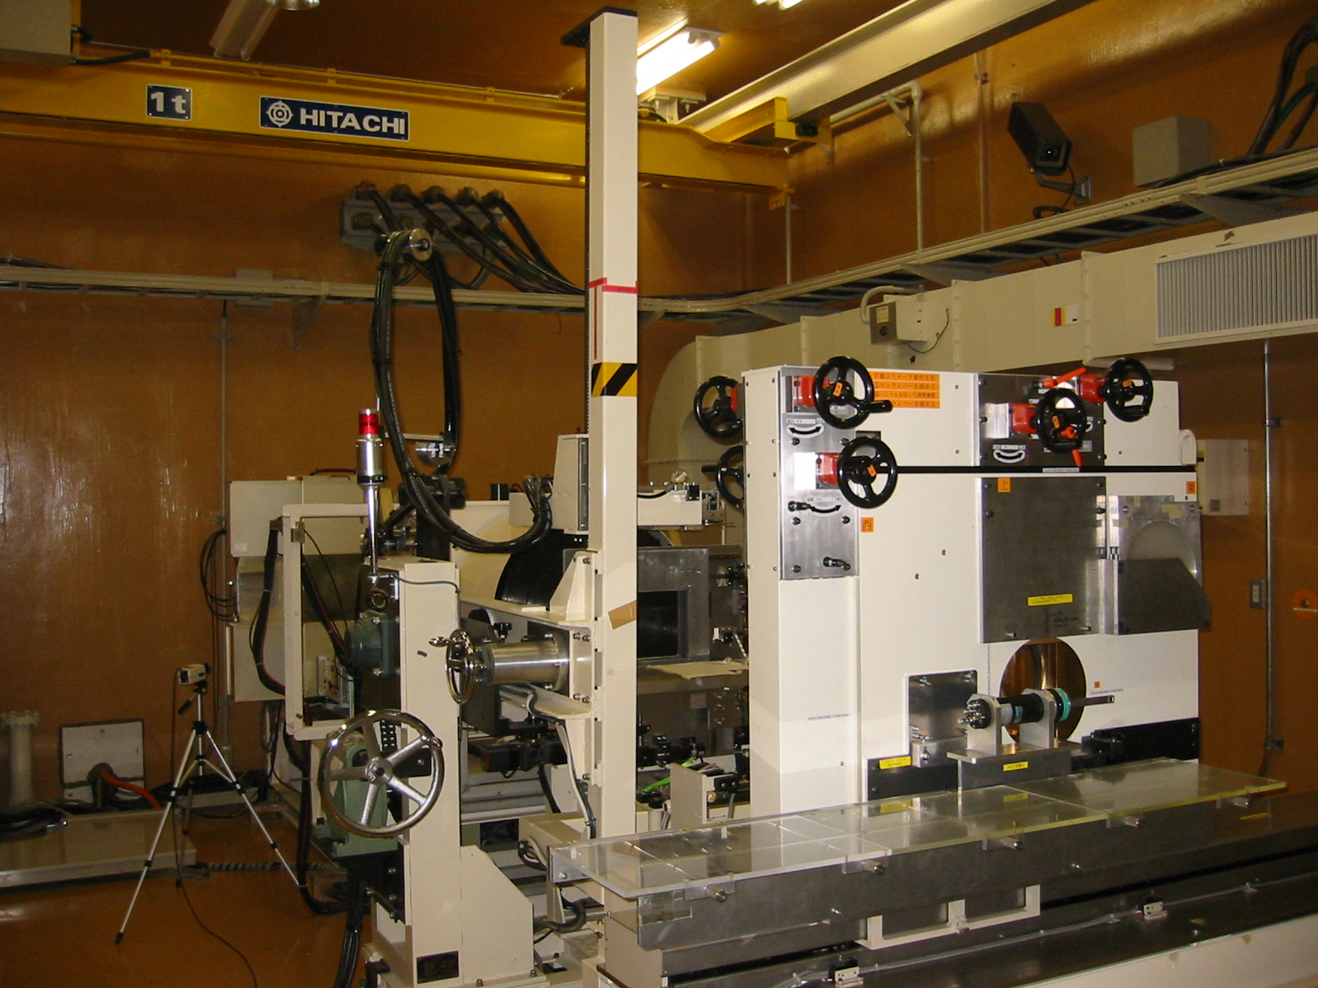
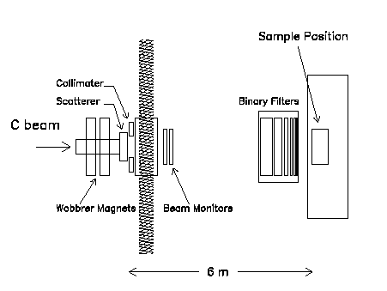
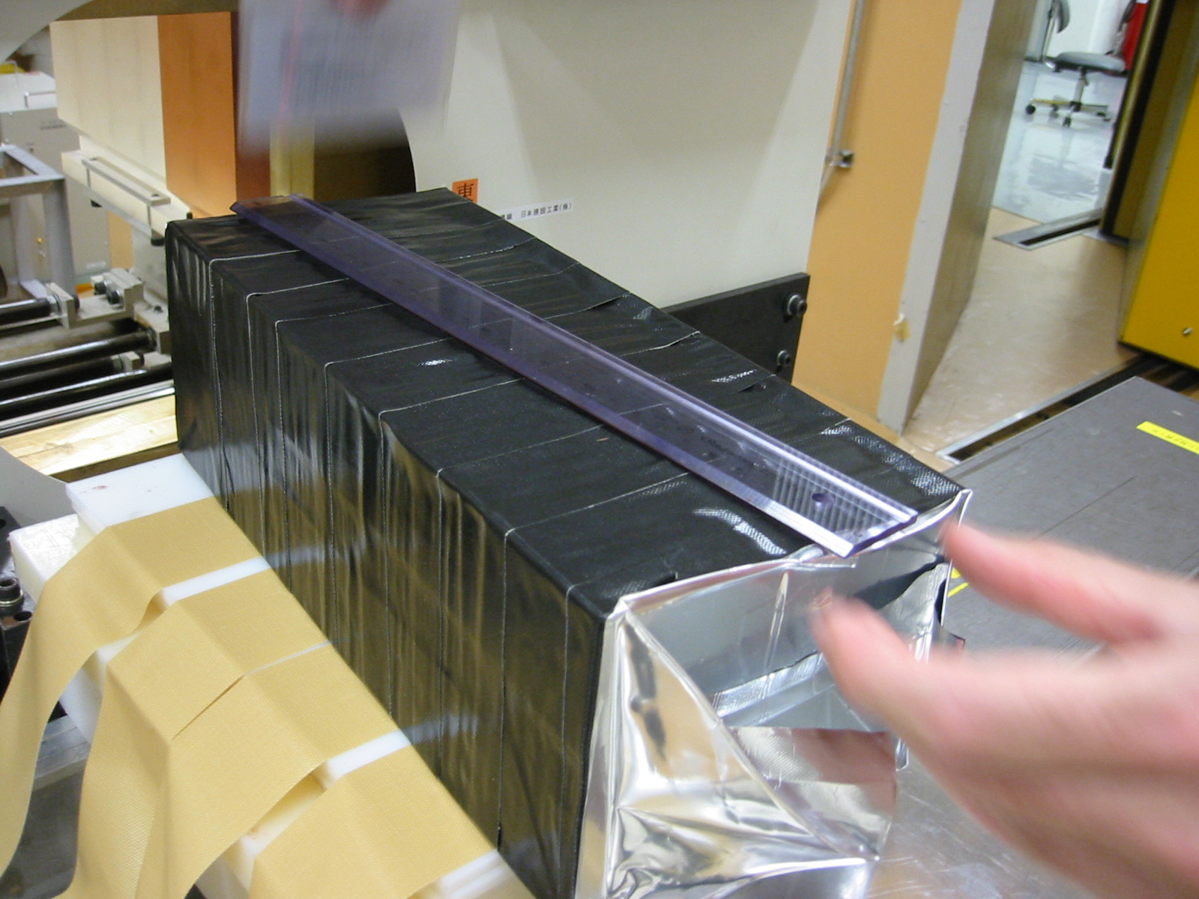
Carbon exposure at HIMAC* (NIRS**- Chiba(Japan))
Emulsion Cloud Chamber (ECC)
*Heavy Ion Medical Accelerator
**National Institute of Radiological Sciences

Slide 10
The structure of the Emulsion Cloud Chamber
ECC structure:
  “OPERA” type: alternate passive and sensitive material
  High resolution tracking device: nuclear emulsion (300 µm thick)
  Passive material: lexan plates 1 mm thick
  73 consecutive “cells”: 219 alternate nuclear and lexan layers
Lexan: ρ=1.15 g/cm³ and electron density=3.6∙10²³/cm³ (water: 3.3∙10²³/cm³)
Elementary
cells
¹²C
300 μm
EMULSION LAYER
1000 μm
LEXAN LAYER

Slide 11
The cell structure of the Emulsion Cloud Chamber
R0
R1
R2
¹²C
LEXAN
LEXAN
Emulsion were differently treated after the exposure and before the chemical treatment according to their position in the elementary cell (0, 1, 2)
LEXAN
300 μm
1 mm
R0:
    Not refreshed
    Developed soon after the exposure
    Sensitive to m.i.p.
R1:
    3 day refreshing at 98% relative humidity at 30°C
    Insensitive to m.i.p.
    Sensitive to protons
R2:
    3 day refreshing at 98% relative humidity at 38°C
    Sensitive to He

Slide 12
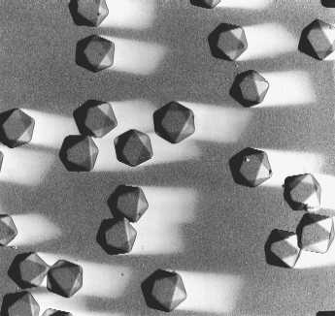
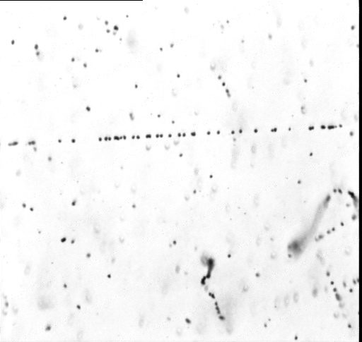
Nuclear emulsion
Charged particle detector
First kind of detector for ionizing radiation
AgBr crystal (0.2 μm) is the elementary detection cell
The particle tracking is registered from the AgBr grains along its path
Microscope image
30-40 grains/100 μm per MIP
50 μm

Slide 13

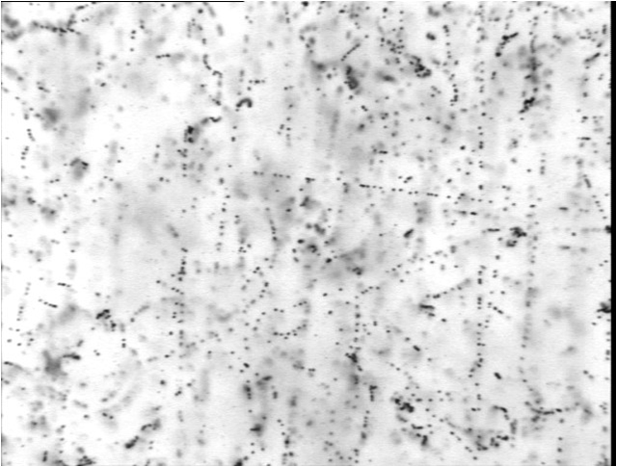
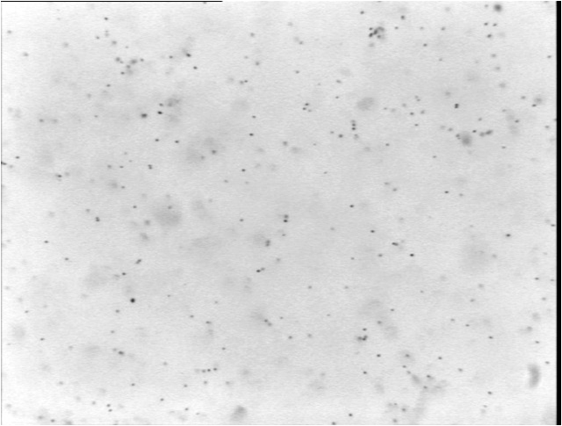
OPERA emulsions
OPERA industrial emulsions from FujiFilm
The AgBr density in the OPERA emulsions is higher in respect to the commercial films
Special R&D for OPERA: the double pouring procedure
Emulsion Layer (43 microns)
Before refreshing
>30 tracks/mm^2
After refreshing
~1 tracks/mm^2
Plastic Base (205 microns)
150 microns
Emulsions are continuously sensitive detector ALL charged particle: cosmic rays, natural radioactivity etc recorded as a latent images. They can be partially erased by a “refreshing” procedure applied just before the detector assembling.

Slide 14
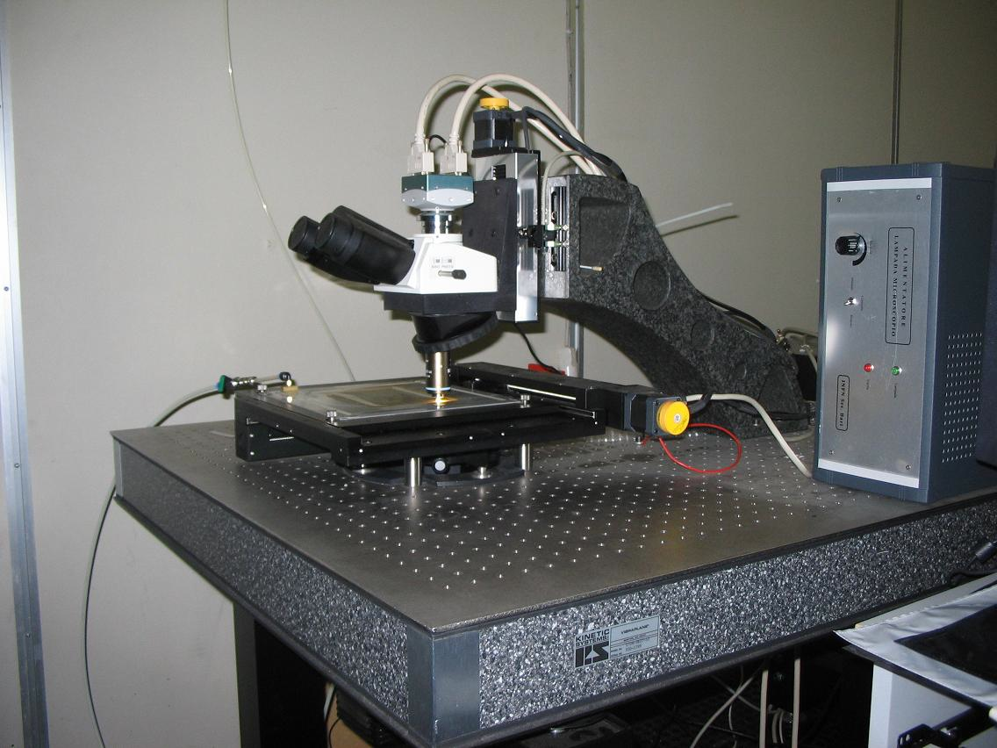
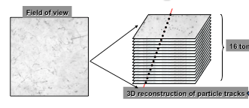
Emulsion scanning system
Illumination system, objective (oil 50× NA0.85) and optical tube (Nikon)
Z
s
t
a
ge
(
M
i
c
o
s
)
0.05 µm no
minal
precisio
n
C
M
O
S
c
a
m
e
r
a
1
2
8
0
×
1
0
2
4
p
i
xe
l
2
5
6
gr
a
y
l
e
v
e
l
s
376 f
r
ames
/s
ec
(Mikr
o
tr
o
n MC1310)
X
Y
s
t
a
ge
(
M
i
c
o
s
)
Em
u
lsi
on
Pla
t
e
0.1 µm no
minal
precisio
n
OPERA expertise in scanning
3d track reconstruction
Scanning speed: 20 cm²/h
Spatial resolution: ~0.3 μm
• Angular resolution: ~2 mrad
• Detection efficiency of the tracks: ~95%
16

Slide 15
Principle of scanning emulsion
16 images taken through 44-micron emulsion layer

Slide 16
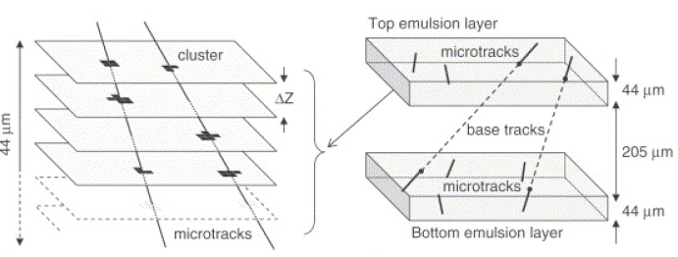
Automatic scanning system
Micro-track reconstruction in one emulsion layer by combining clusters belonging to images at different levels.
Micro-tacks are connected across the plastic base to form a base-tracks.

Slide 17
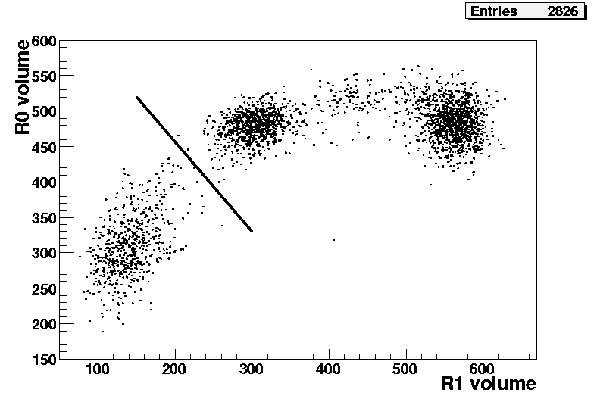
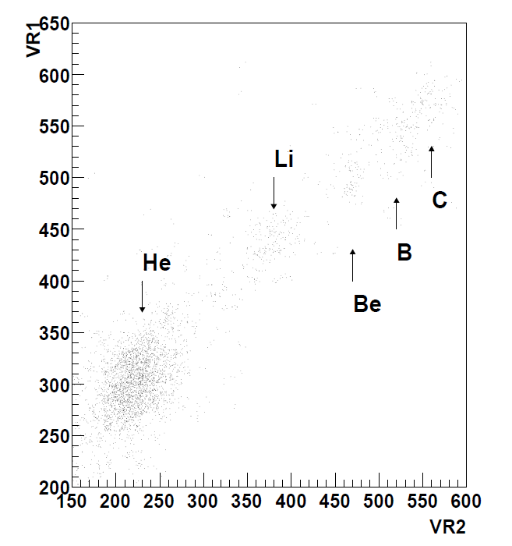
Combining the information on consecutive films to get rid of the saturation effect R0 vs R1 and R1 vs R2 scatter plot
Results
He
H
Journal of Instrumentation 2 (2007) P06004

Slide 18
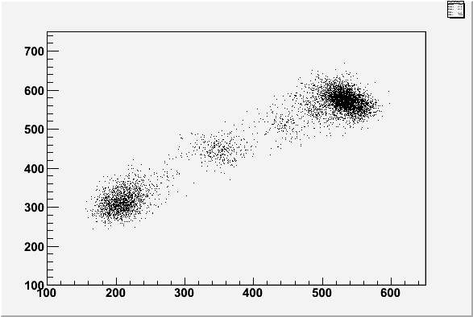
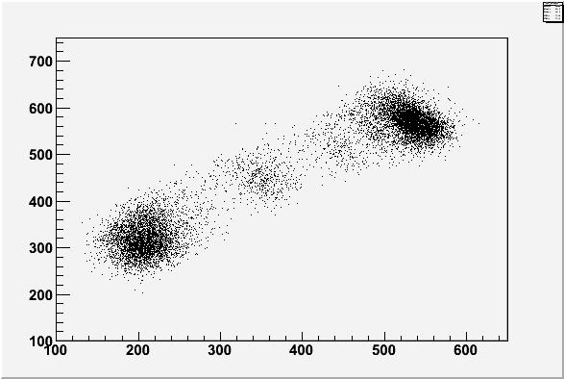
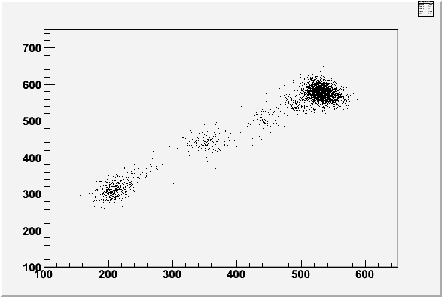
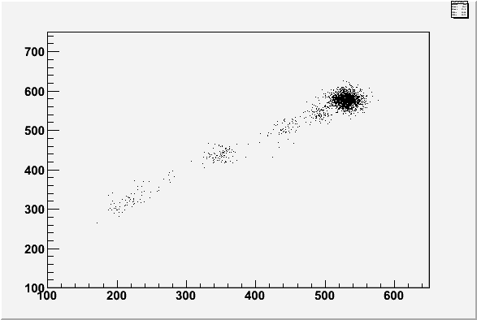
Charge identification
2 cm thick chamber
4 cm thick chamber
Z = 4
Z = 3
Z = 2
6 cm thick chamber
8 cm thick chamber
Z = 6
Z = 5
Z = 4
Z = 3
Z = 2

Slide 19
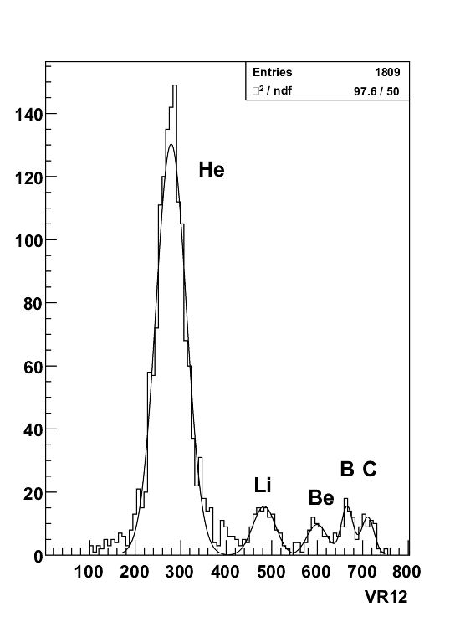
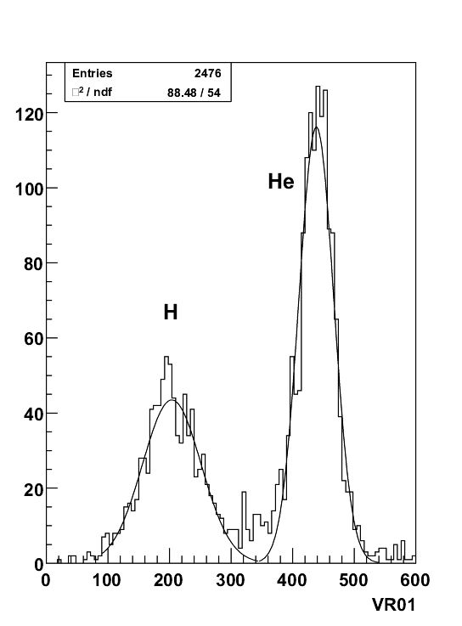
Charge separation
Journal of Instrumentation 2 (2007) P06004

Slide 20
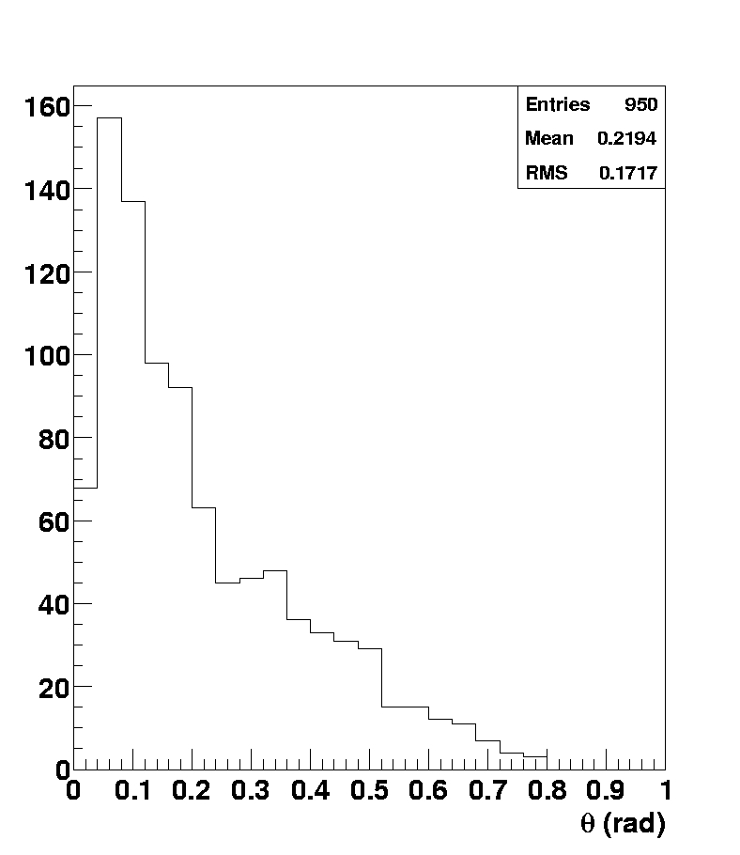
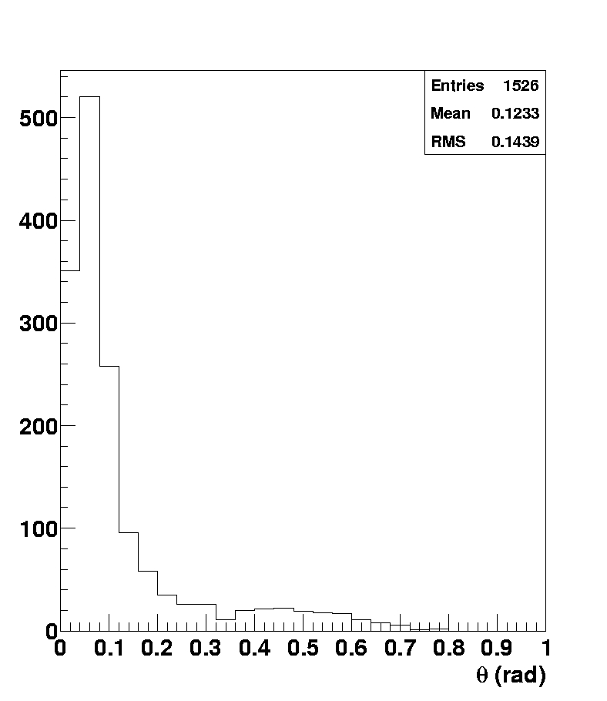
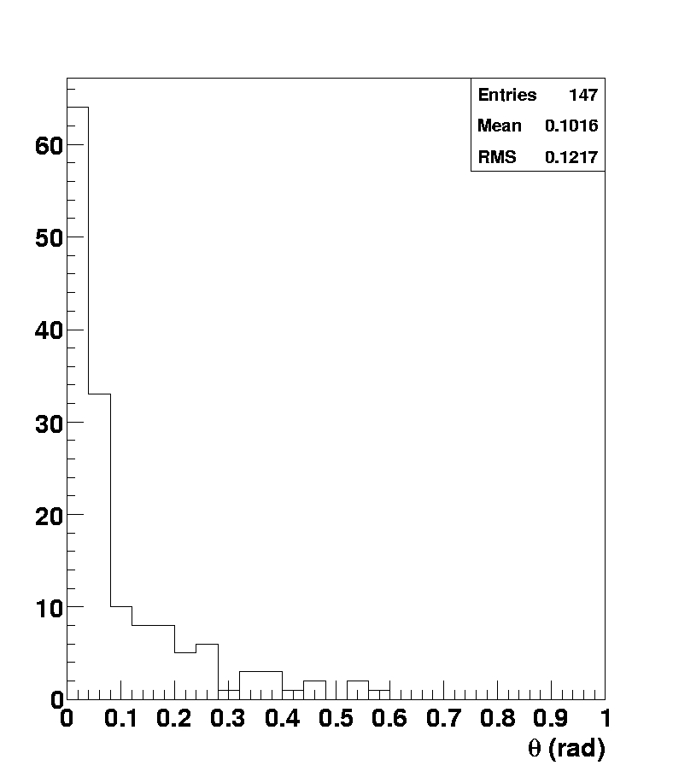
Scattering angle of emitted particles
Hydrogen
Helium
Lithium

Slide 21
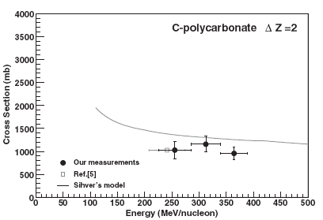
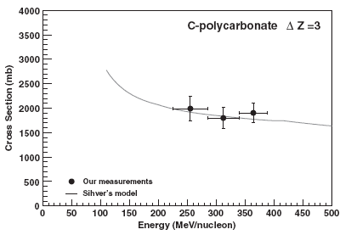
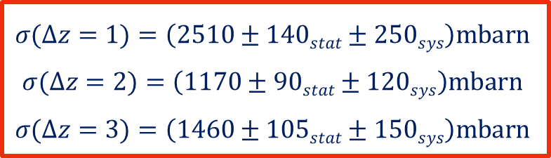
Cross-section measurement
A volume of about 24 cm³ analyzed
Average energy of the Carbon beam: 315 MeV/n
Counting the events with Lithium (Δz = 3), Beryllium (Δz = 2) and Boron (Δz = 1) as the heaviest particle in the final state
$$σ(∆z=1)=\left(2510±140stat±250sys\right)mbarn$$
$$σ(∆z=2)=\left(1170±90stat±120sys\right)mbarn$$
$$σ(∆z=3)=\left(1460±105stat±150sys\right)mbarn$$
Black points: Phys.Rev.C75 (2007) 054606

Slide 22
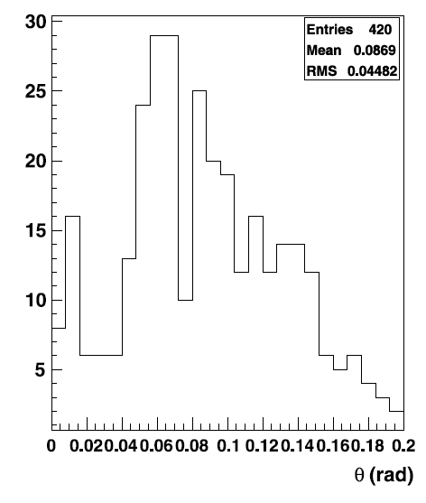
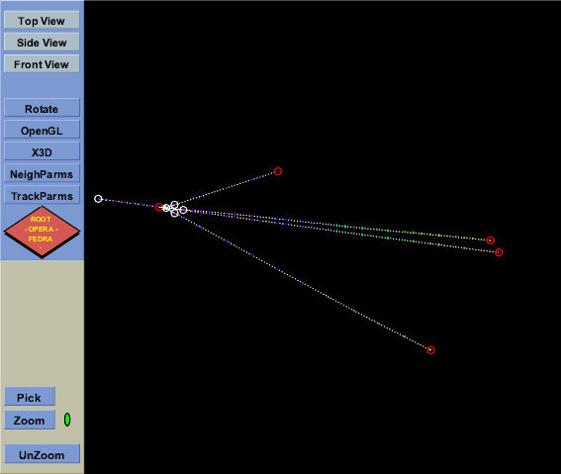

⁸Be production Cross Section
⁸Be → He + He (10⁻¹⁶ s)
Q value 90 keV → small opening angle
Opening angle between pairs of reconstructed Helium tracks
One event
p
He
C
He
Peak at 20≈mrad
p
$$σ(C→8Be)=\left(190±40\right)mbarn$$

Slide 23
Outline
  Hadrontherapy motivation
  The ¹²C fragmentation measurement with the Emulsion Cloud Chamber (ECC) detector
  The FIRST detector
  Measurements at GSI in the FIRST set-up
  Preliminary results
  Conclusion

Slide 24
  FIRST experiment
FIRST: Fragmentation of Ions Relevants for Space and Therapy
Aim:
  Production yelds of Z=0, 1, 2 ,3 ,4 ,5 fragments
  Measurement of cross section wrt angle and energy, with large angular acceptance
A collaboration among:
  INFN: Cagliari, LNF, LNS, Milano, Napoli, Roma3,Torino;
  DSM/IRFU/SPhN CEA Saclay, IN2P3 Caen, Strasbourg, Lyon;
  GSI:
      Therapeutical beam of ¹²C @ 200-400 MeV/n available
      Existing setup designed for higher E and Z fragments: Dipole magnet, Large Volume TPC, TOF Wall, low angle Neutron detector.
  ESA, CERN

Slide 25
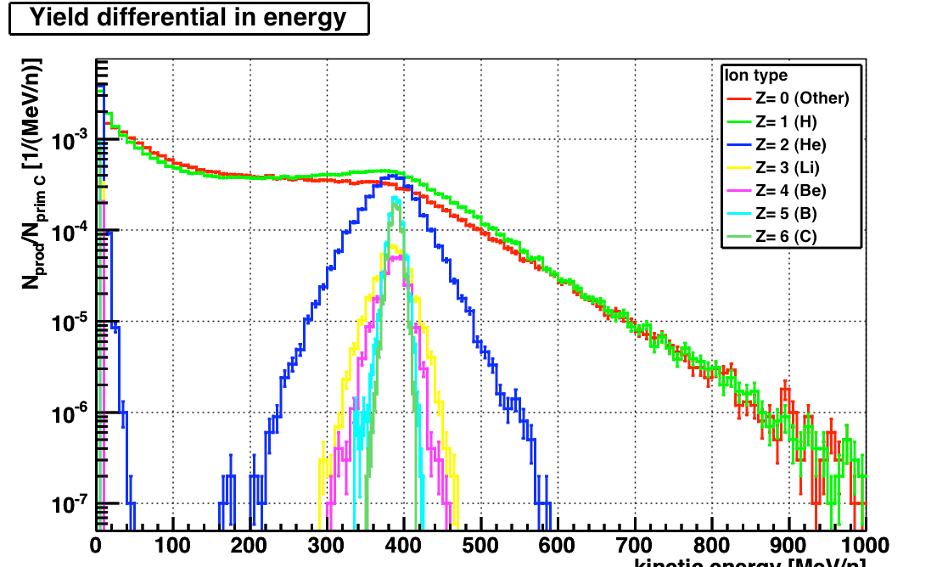
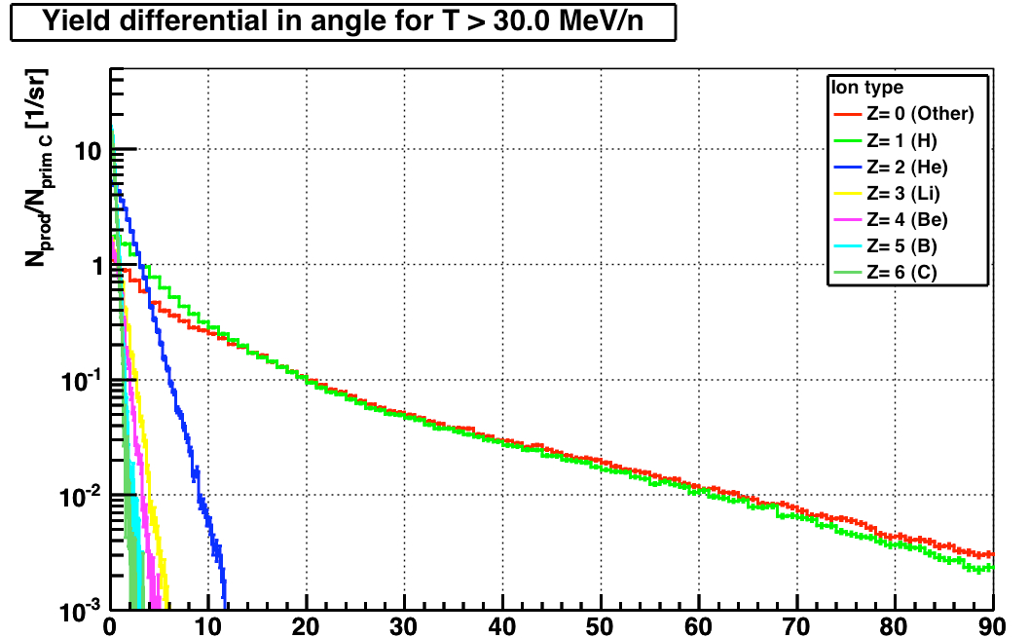
What do we expect from MC (FLUKA)?
The Z>2 produced fragments approximately have the same velocity of the ¹²C beam projectiles and are collimated in the forward direction
The protons are the most abundant fragments with a wide angular distribution and a kinetic energy spectrum up to 1 Gev/n
The Z=2 fragment are emitted within 20°of angular aperture
Kinetic energy (MeV/nucl)
Emission angle (deg)

Slide 26
  FIRST set up
The measurements were performed at the GSI facilities, where a therapeutical beam of ¹²C @ 200-400 MeV/n is available
Fragments
LAND
Incident
Beam
6°
Target
KENTROS
Interaction region:
Start counter
Beam monitor
Vertex detector
Proton tagger
ALADIN
Bending magnet
(<6°)
VETO COUNTER
Identifies particles coming from primary beam
MUSIC
Energy particles
Slope particles
TIME OF FLY
WALL

Slide 27
Outline
  Hadrontherapy motivation
  The ¹²C fragmentation measurement with the Emulsion Cloud Chamber (ECC) detector
  The FIRST detector
  Measurements at GSI in the FIRST set-up
  Preliminary results
  Conclusion

Slide 28
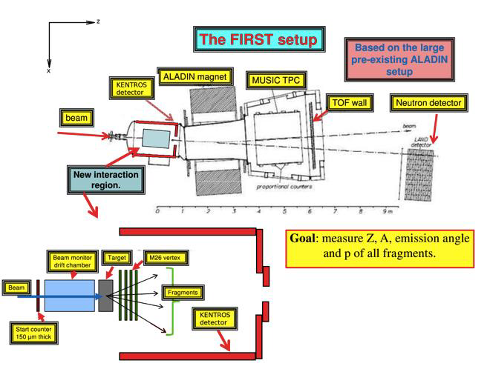
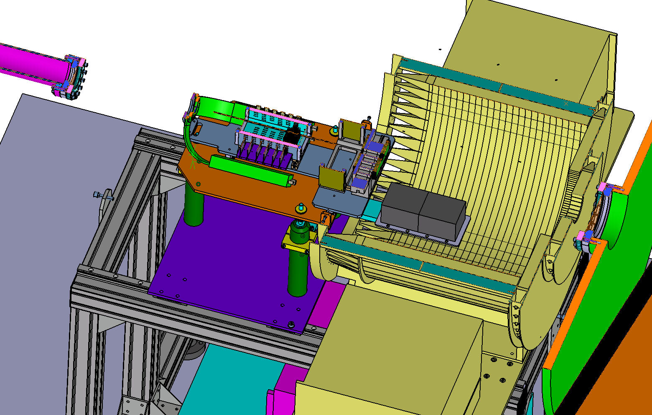
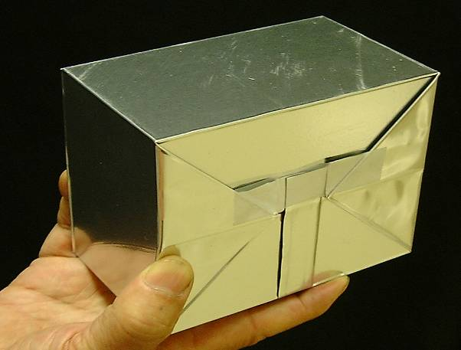
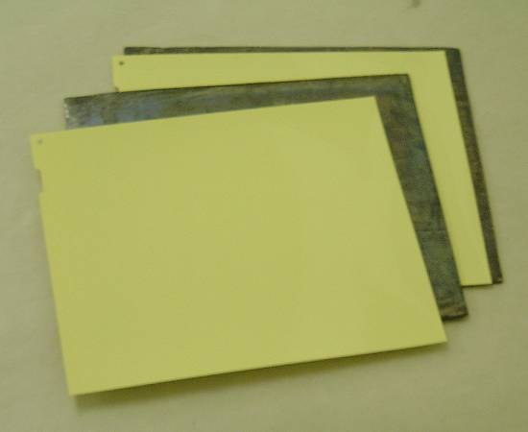
The FIRST set-up
ECC
ECC1
ECC2
10.2cm
ECC
12.5cm
“FIRST experiment: Fragmentation of Ions Relevant for Space and Therapy”
Journal of Physics: Conference Series 420 (2013) 012061 doi:10.1088/1742-6596/420/1/012061

Slide 29
Beam exposure of ECC
¹²C beam with 400 MeV/n
Carbon target (8 mm thick)
Two ECC were collocated inside the detector FIRST
Dedicated study on large angle track detection
beam
a ≈ 16.5 cm
α₂
α₁
b ≈ 0.5 cm
ECC2
ECC1
2°≤ α₂ ≤ 38°
38°≤ α₁ ≤ 57°

Slide 30
ECC strucutre
ECC structure:
Not homogeneous structure
6 consecutive emulsion films
56 nuclear emulsion layers (300 μm) interleaved with 56 lead plates (1 mm)
10.2cm
12.5cm
film 62
6 consecutive emulsions
film 57
film 56
1 mm lead layer
ECC
300 μm nuclear emulsion
film 2
film 1

Slide 31
Outline
  Hadrontherapy motivation
  The ¹²C fragmentation measurement
  The Emulsion Cloud Chamber (ECC) detector
  The FIRST detector
  Measurements at GSI in the FIRST set-up
  Preliminary results
  Conclusion

Slide 32
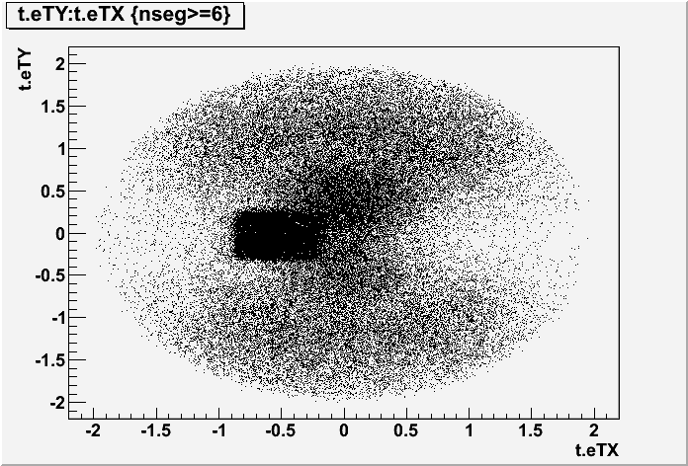
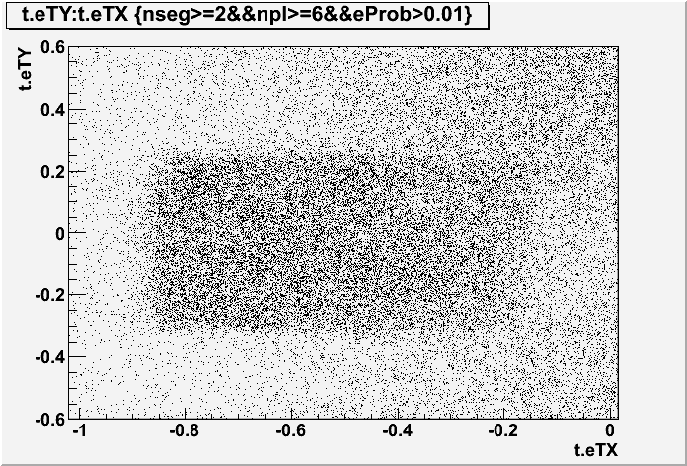
ECC 2: Tracks angular distribution
Signal and cosmic rays
20 emulsions were scanned (6 consecutive emulsions and 14 emulsions interleaved with lead)
Data were scanned and processed up to tg θ ≤ 2
Signal cut:
-0.9 ≤ tg Θ_{x} ≤ -0.1
-0.3 ≤ tg Θ_{y} ≤ 0.28)
Signal is effectively measured at:
3°≤θ≤ 40° (for ECC2)
40°≤θ≤ 60° (for ECC1)
as it was expected from the exposition geometry

Slide 33
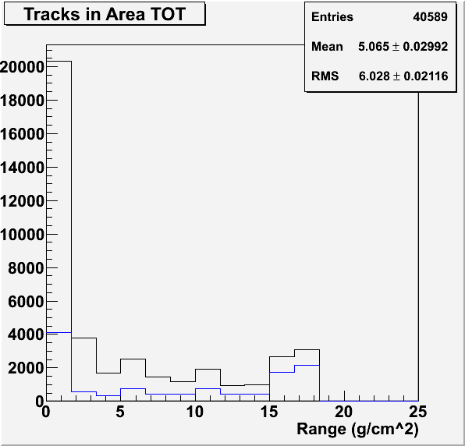
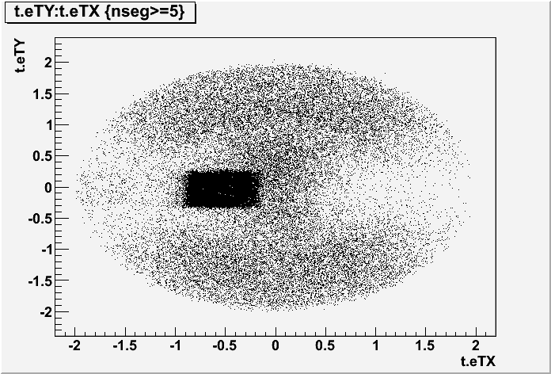
Signal and cosmic ray
range distribution
Tracks selected:
-0.9 ≤ tg Θ_{x} ≤ -0.1
-0.3 ≤ tg Θ_{y} ≤ 0.28
number of segments ≥ 2
Signal
Cosmic rays
preliminary results

Slide 34
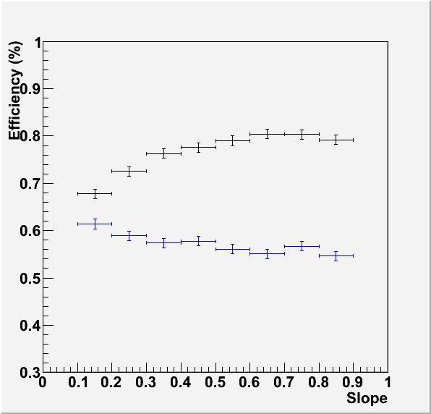
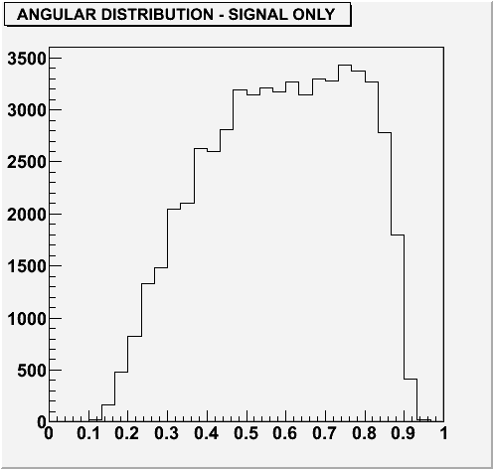
Efficiency vs tracks slope
Reconstruction efficiency
Signal
Cosmic rays
Angular distribution of only signal
corrected by efficiency
CR/(S+CR)=24.4%
preliminary results

Slide 35
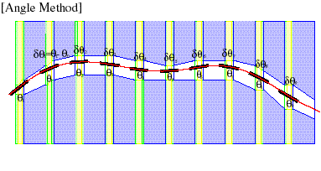
Kinematical measurements
1. Momentum measurement by multiple coulomb scattering (MCS)
From the slope measurements along the particle track of the same particle obtained from the ECC it is possible to calculate the particle impulse in the range: 200 MeV/c ÷ 2 GeV/c
13.6
x
The algorithm was used for OPERA experiment and is based on:
p (MeV/c) =
X₀
β δθ (mrad)
“Momentum measurement by the angular method in the Emulsion Cloud Chamber”,
Nuclear Instruments and Methods in Physics Research A 512 (2003) 539–545

Slide 36
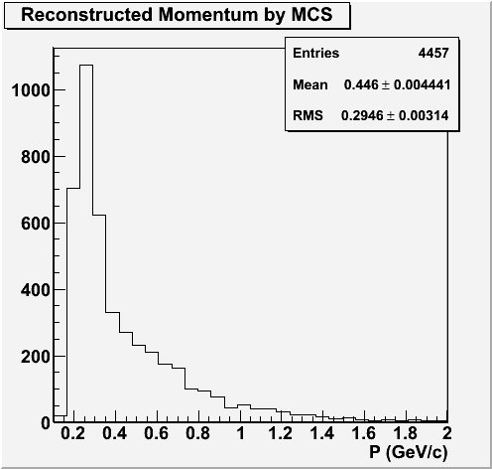
Kinematical measurements
1.Momentum measurement by MCS
Tracks behind the first 6 emulsions
Tracks with at least 3 segments passing through
11 % of the total tracks of the sample
preliminary results

Slide 37
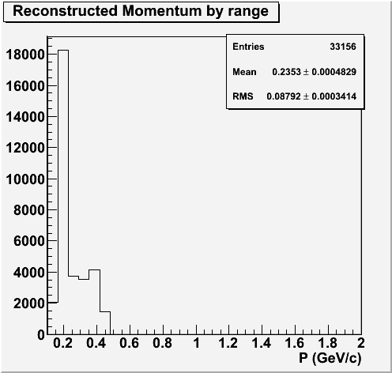
Kinematical measurements
2. Momentum measurement by range
Tracks for which it is not possible the measurement by the MCS method
Tracks stopped in the first 6 emulsions
Tracks not stopped inside the considered volume (20 layers)
82 % of the total tracks of the sample
preliminary results

Slide 38
Outline
  Hadrontherapy motivation
  The ¹²C fragmentation measurement with the Emulsion Cloud Chamber (ECC) detector
  The FIRST detector
  Measurements at GSI in the FIRST set-up
  Preliminary results
  Conclusion

Slide 39
Conclusions
Emulsion Cloud Chamber technique used to study the fragmentation of Carbon ions
  Homogeneous ECC used as target and detector
  Not Homogeneous ECC used as detector
From these studies:
Discrimination of produced fragments in Z
Charge-changing cross-section measured
Moment measurement with MCS algorithm and range method

Slide 40
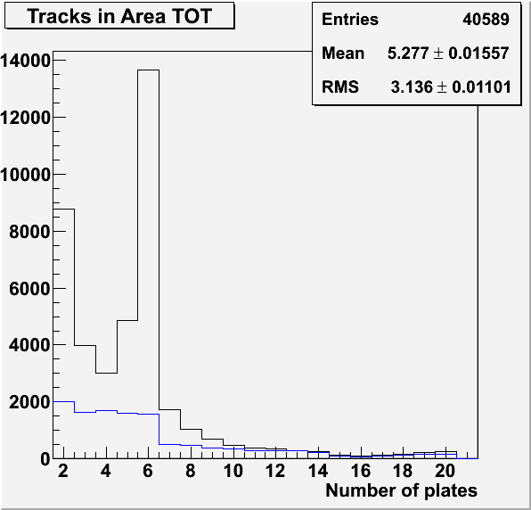
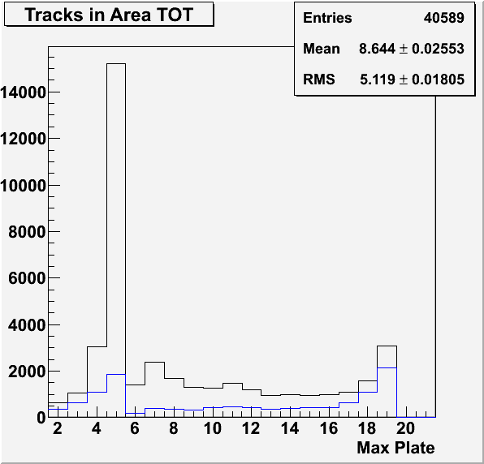
Backup slides

Slide 41
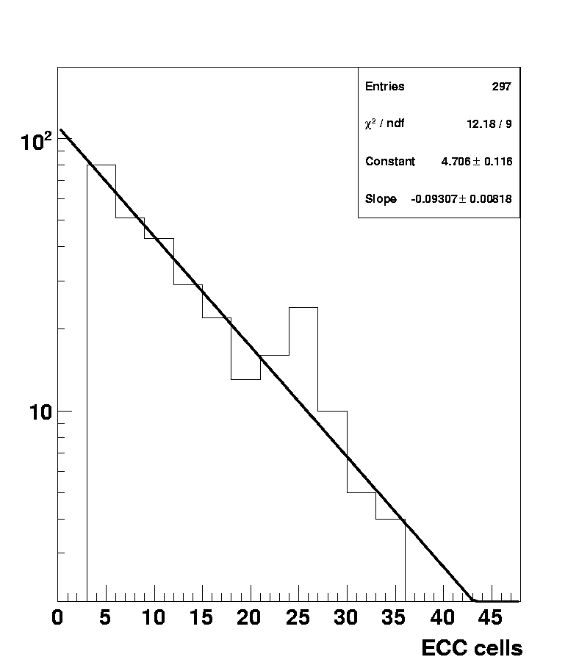
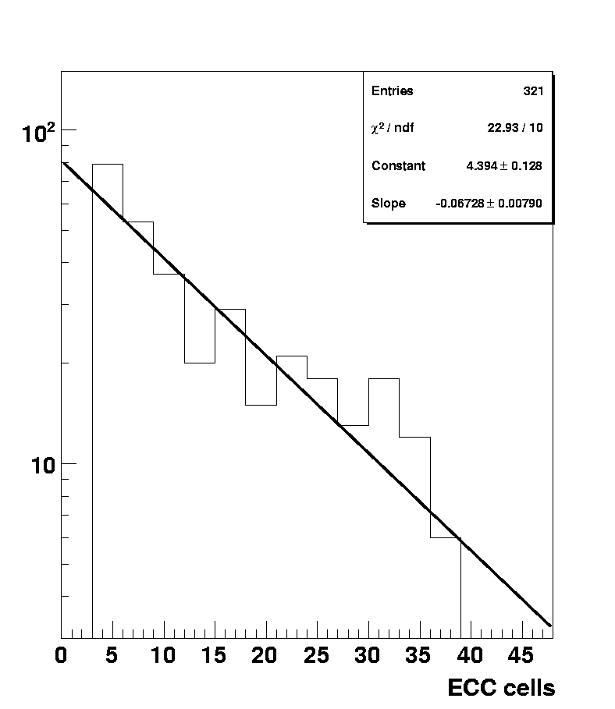
Interaction length of secondary ions

Slide 42
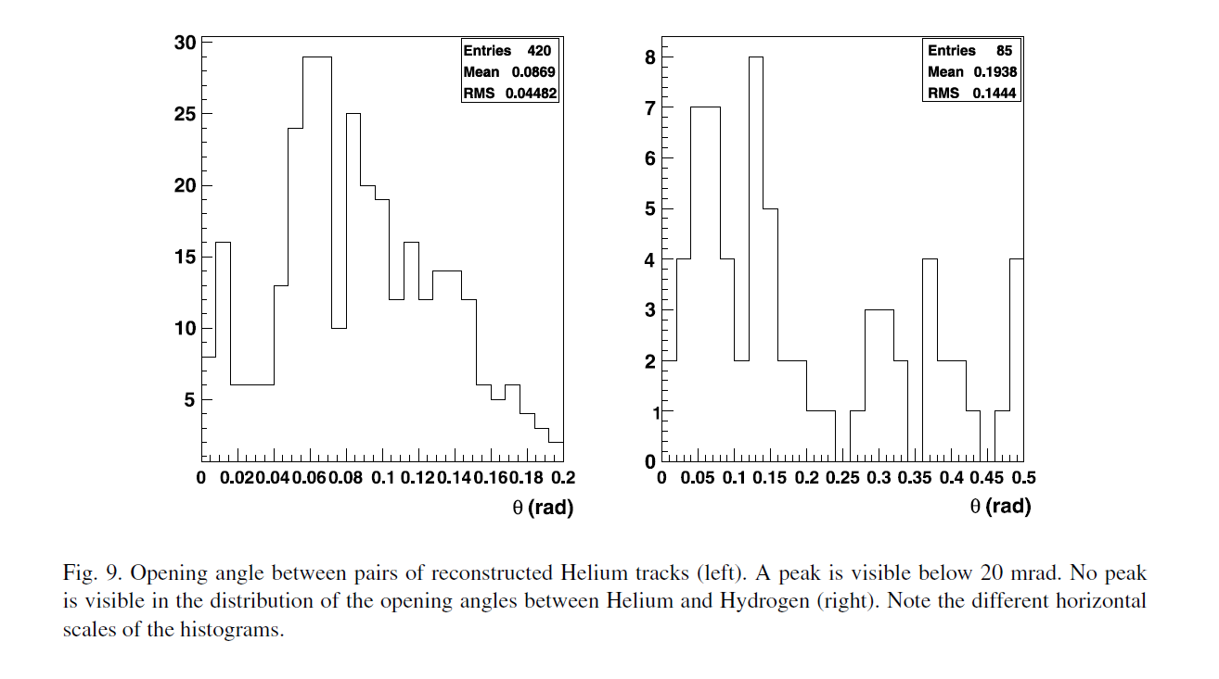



Slide 44

Reconstruction efficiency
Tracks selected:
angle selection
number of segments ≥ 2
Number of plates ≥ 6
Signal
Cosmic rays
-0.9≤ tg Θ_{x} ≤ -0.1
-0.3 ≤ tg Θ_{y} ≤ 0.28
0.1≤ tg Θ_{x} ≤ 0.9
-0.3 ≤ tg Θ_{y} ≤ 0.28)

Slide 45

Data (images) processing and motion control flow in the ESS
Tomographic sequences
Z axis moving, 2D images
spanning emulsion thickness
280×365μm²
Next field of view,
Z at top, new cycle
DAQ cycle
(185 ms)
Process/save data
Move XYZ to next view
Camera
Image Processor board
(Matrox Odyssey)
Host PC
(Dual Pentium
Workstation)
Running
WinXP
2D Images
(peak 452 MB/s,
avg. 97 MB/s)
Binarized
2D Images
Motors
(VEXTA
Nanostep)
Motion Controller
(National Instruments
FlexMotion)
3D
microtracks
XYZ Motion
Commands
Power
Functional blocks

Slide 46


Cosmic-ray angular distribution
Films transported from Gran Sasso to CERN
Brick assembled at CERN
Cosmic-ray integrated during the transportation of the brick from CERN to GSI and from GSI to Gran Sasso
Brick disassembled and film developed at Gran Sasso
Cosmic-rays taken with the films inside the
brick in the same geometrical configuration
as for the beam at GSI, with the brick rotated
by 90 degrees to minimize the flux

